Slide 1
GEOGRAPHY
TECHNOLOGY

Slide 2
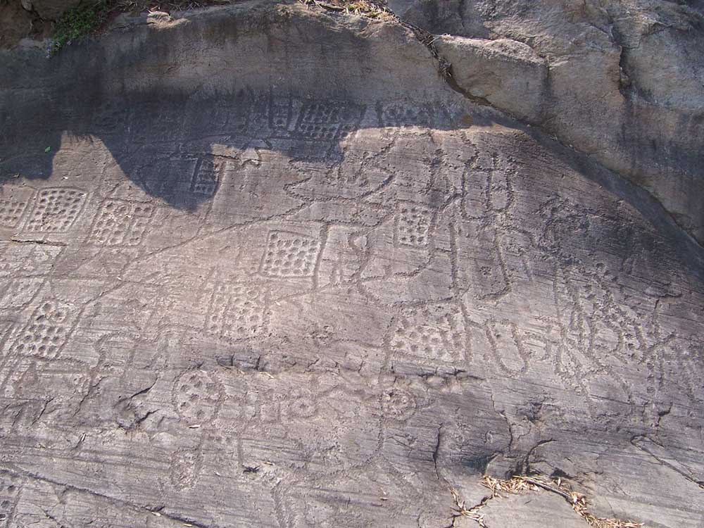
HISTORY OF MAPS
Earliest Maps
Used to navigate short distances
Meant to visualize small geographic spaces (such as the a short path or a simple city)
Babylonian civilization and Greece.
Bedolina map, 2008. Photograph by Luca Giarelli. Wikimedia Commons

Slide 3
PTOLEMY’S GEOGRAPHIA
Unlike past maps (artistic), Ptolemy took a mathematical approach
Created a system of latitude and longitude
Became the prototype of the modern map

Slide 4
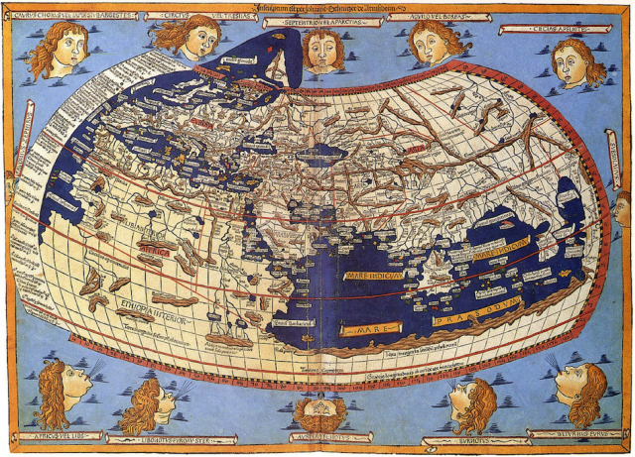
Ptolemy’s Geographia

Slide 5
MIDDLE AGES
Europe
Development stagnated
Religious fervor
Maps decorated with religious iconography
Geocentrist
Middle East
Cartography shifts into a science instead of an art
Relying on calculations
Latitude and Longitude

Slide 6
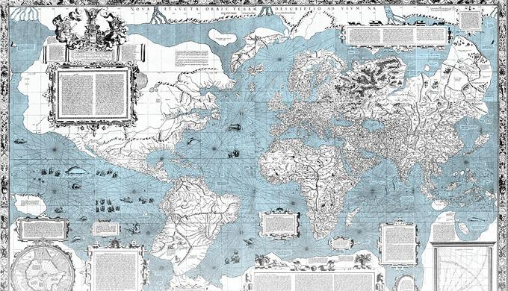
1569: The Mercator Projection
Circumnavigation proved the Earth was round
Distorted size at the poles to fit spherical Earth onto a flat plant
Dominant projection in modern day

Slide 7
POST -INDUSTRIAL MAPS
Demand & Remote Sensing
Freedom of travel
Affordable, compact, and accurate
kites, balloons, and birds to collect data
Eventually used airplanes instead
Digitization
Easier to correct, expand, and manipulate in ways paper was not
Global Positioning Systems (GPS)
Cold War
Made for the military
Given to the public in the 1980s

Slide 8
GIS (GEOGRAPHIC INFORMATION SYSTEMS)
“capturing, storing, checking, and displaying data related to positions on Earth's surface”
Uses layers, asses and isolates relevant data
For example: A map that overlays pollution levels with population density
Uses standard computer hardware
Requires a large amount of memory due to vast file sizes and amounts of data stored.
Both MacOS and Windows have the hardware to run GIS but the software is optimized for Windows
Most used software is ArcGIS and QGIS

Slide 9
USAGE
Visualize and communicatie environmental data and tracking trends
Discover trends that weren’t apparent to the naked eye
Developing sustainable, future forward cities to support a growing population and urbanization
Better visualize the needs of a city through remote sensing, seeing a greater perspective on land and infrastructure.
Quickly editable, can adapt to a growing city.

Slide 10
POPULAR CULTURE (POKEMON GO)
The user can travel in the real world environment and collect virtual Pokemon.
Travelling to local landmarks, such as a church or a statue, can give user rewards.
Niantic, the startup company behind Pokemon Go, started in Google
It’s CEO had worked on Google Earth and Google Maps in the past.
As Niantic grew bigger, it became fully independent and was able to begin work on Pokémon Go.
n late 2017, they switched from a Google Maps base to the crowdsourced OpenStreetMap, which “makes it possible for user edits to add more details about specific areas and adapt more quickly to changes like road closings”

Slide 11
MOBILE NAVIGATION
Google Maps
Started in 2005
App released in 2007
Change from printouts (MapQuest) to real-time, adaptable technology.

Slide 12
